Slide 1
Olist Brazilian E-Commerce: from raw data to dashboard
DATA ANALYSIS MINI PROJECT · DEPI, ITC ONLINE GROUP 3, TEAM 3
Dataset discovery, SQL database, Python cleaning, Power BI measures and a four-page dashboard covering Jan 2017 to Aug 2018
Notes:
Welcome. This is the story of how our team took a public e-commerce dataset and turned it into a database and an interactive dashboard. Each stage fed the next.

Slide 2
Objective and why this dataset
Objective
The dataset
Why it fits
Understand sales, customers and delivery performance of a Brazilian online marketplace.
Brazilian E-Commerce Public Dataset by Olist, found on Kaggle by Mohamed Sokarno.
A relational structure of customers, orders, items, products and more, suited to SQL, cleaning and BI work.
THE PROJECT JOURNEY
1. Discover
2. Model in SQL
3. Clean
4. Measure
5. Dashboard
Olist E-Commerce Analysis · DEPI ITC Online Group 3, Team 3 · 2
Notes:
We chose Olist because it is a real, multi-table relational dataset. The five steps along the bottom are the order of the rest of this presentation.

Slide 3
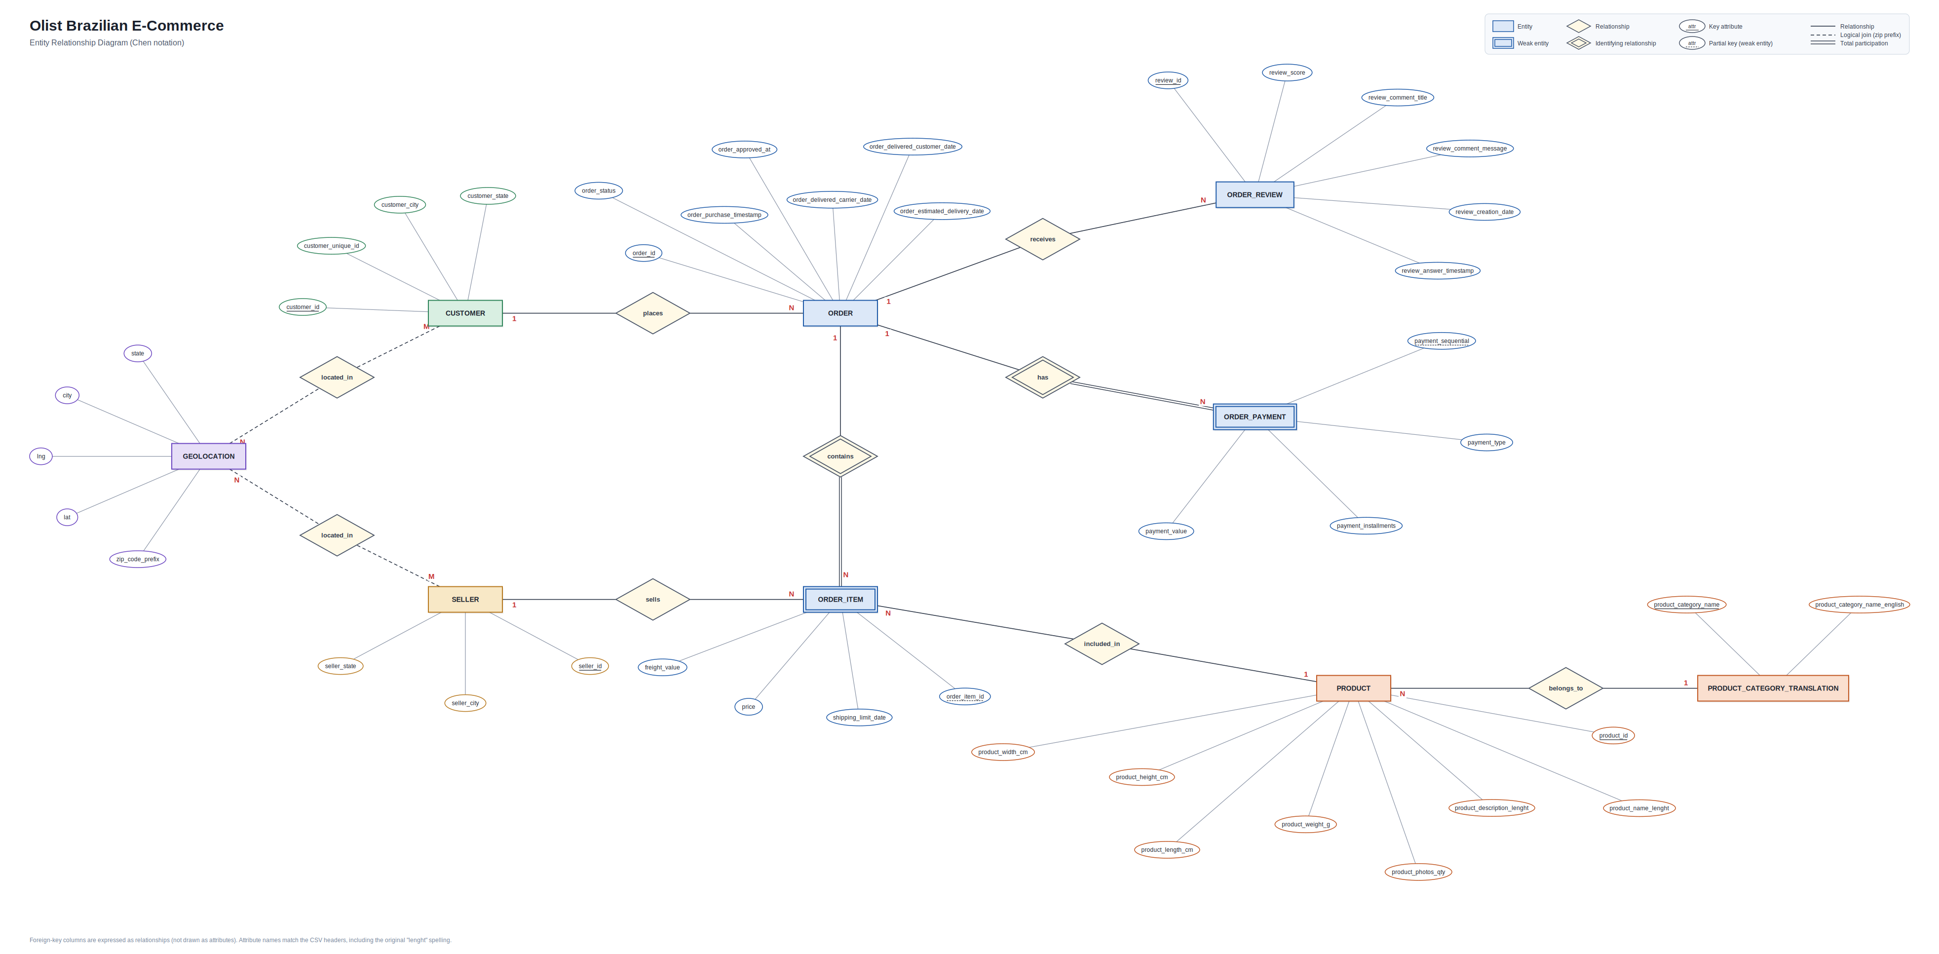
The original dataset and its structure
Source ERD (Chen notation) by Mahmoud Al-Nabawi: nine entities including customers, orders, items, payments, reviews, sellers, products and geolocation.
Olist E-Commerce Analysis · DEPI ITC Online Group 3, Team 3 · 3
Notes:
This is the ERD of the original dataset, drawn by Mahmoud Al-Nabawi, who also contributed to the data dictionary. It explains why the dataset is rich enough for the project. Do not confuse it with the final four-table design shown two slides later.

Slide 4
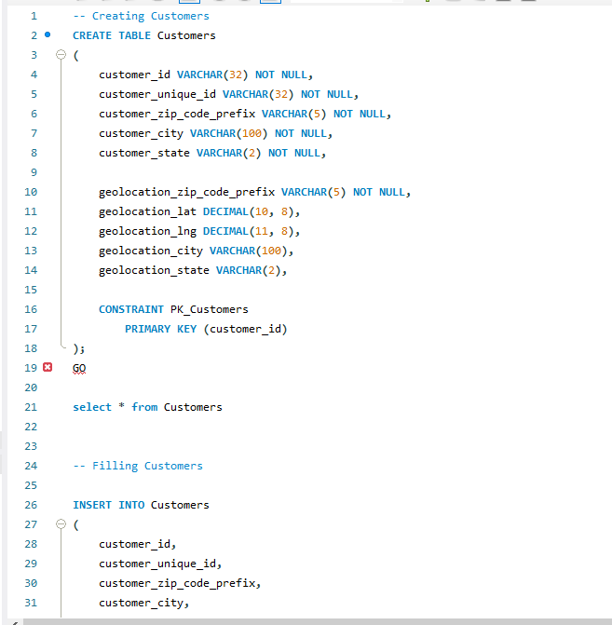
SQL implementation
Schema and tables
Database, schema and tables created in SQL, e.g. Customers with customer_id as primary key.
Loading
Data loaded with INSERT statements and joins into the four target tables.
Encoding fix
Text encoding issues were investigated and corrected by converting to UTF-8.
Open item: the payment_installments Boolean note is not confirmed by the final ERD.
Olist E-Commerce Analysis · DEPI ITC Online Group 3, Team 3 · 4
Notes:
Mohamed Sokarno created the database and loaded the data. The screenshot shows the Customers table definition. Validation of the load is described qualitatively only, since no row counts were supplied.

Slide 5
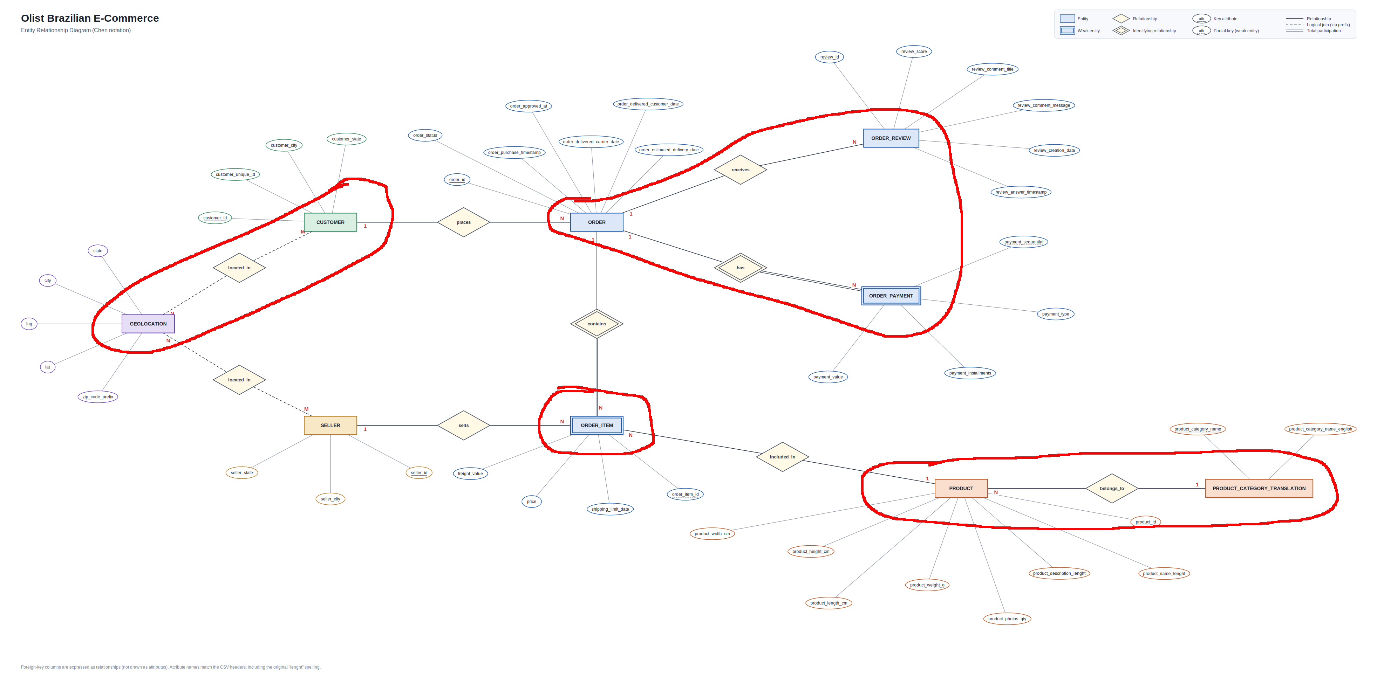
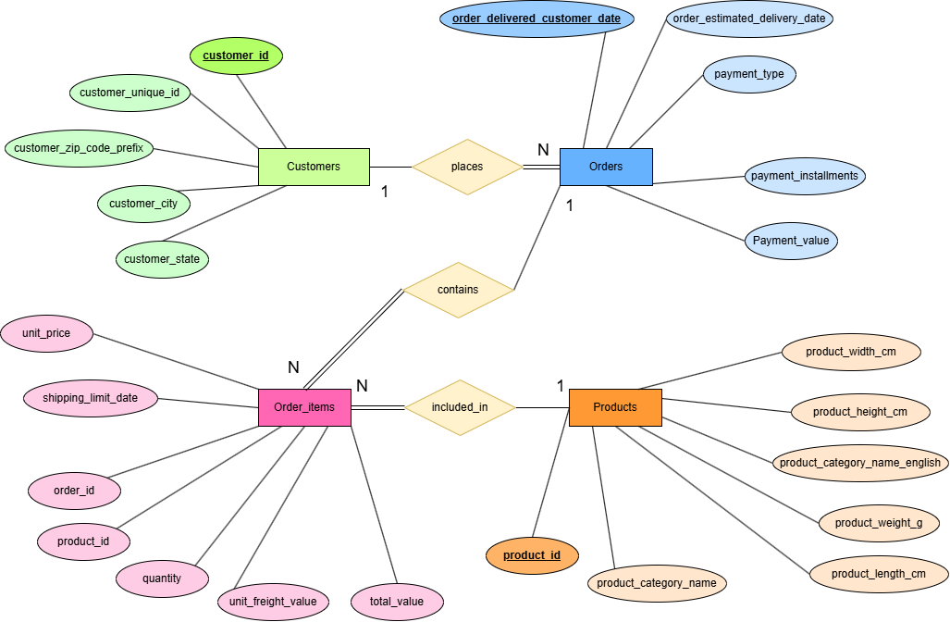
From source ERD to the final four-table schema
Before: original source with nine entities.
Key relationships: one Customer places many Orders; one Order contains many Order items; one Product is included in many Order items.
After: Customers, Orders, Order_items, Products.
Olist E-Commerce Analysis · DEPI ITC Online Group 3, Team 3 · 5
Notes:
Left is the original source structure; right is the final database design with four tables. Mohamed Sokarno shaped the target design and considered normalisation, denormalisation and redundancy. A design note says payment_installments became a Boolean; the final ERD still lists it as an attribute, so we do not claim that change until it is confirmed.

Slide 6
Data cleaning and quality checks
Clean the cells
Check unusual values
Removed empty rows and duplicates; standardised column names and text; handled missing values; corrected data types.
Looked for outliers and unexpected values in each column.
Check relationships
Flag, do not delete
Orders reference existing customers; order items reference existing products; dates stay consistent across tables.
Suspicious records were flagged for review instead of being removed automatically.
Lesson: data quality is also about relationships between tables, not only clean cells. Python notebook by Mohamed El-Gml.
Olist E-Commerce Analysis · DEPI ITC Online Group 3, Team 3 · 6
Notes:
Mohamed El-Gml cleaned and prepared the data in a Python notebook. We deliberately do not quote error counts here, because they come from the generated quality report, which is not part of this deck.

Slide 7
Power BI measures and the Calendar table
Sales and revenue
Orders and customers
Sales, freight, revenue, average order value, units, products.
Delivered orders, unique and repeat customers (based on customer_unique_id).
Time intelligence
Cancellations and delivery
Calendar table plus YTD and month-over-month comparisons; guarded MoM hides results when the prior-month base is under 1,000.
Cancellations, late and on-time delivery logic.
Built by Mahmoud Saqr, as described in the project notes. Final DAX definitions still to be validated.
Olist E-Commerce Analysis · DEPI ITC Online Group 3, Team 3 · 7
Notes:
Mahmoud Saqr built the Calendar table and the measures. Using customer_unique_id matters because one person can have several customer_id values. The guarded MoM rule stops tiny early months from producing huge percentages.

Slide 8
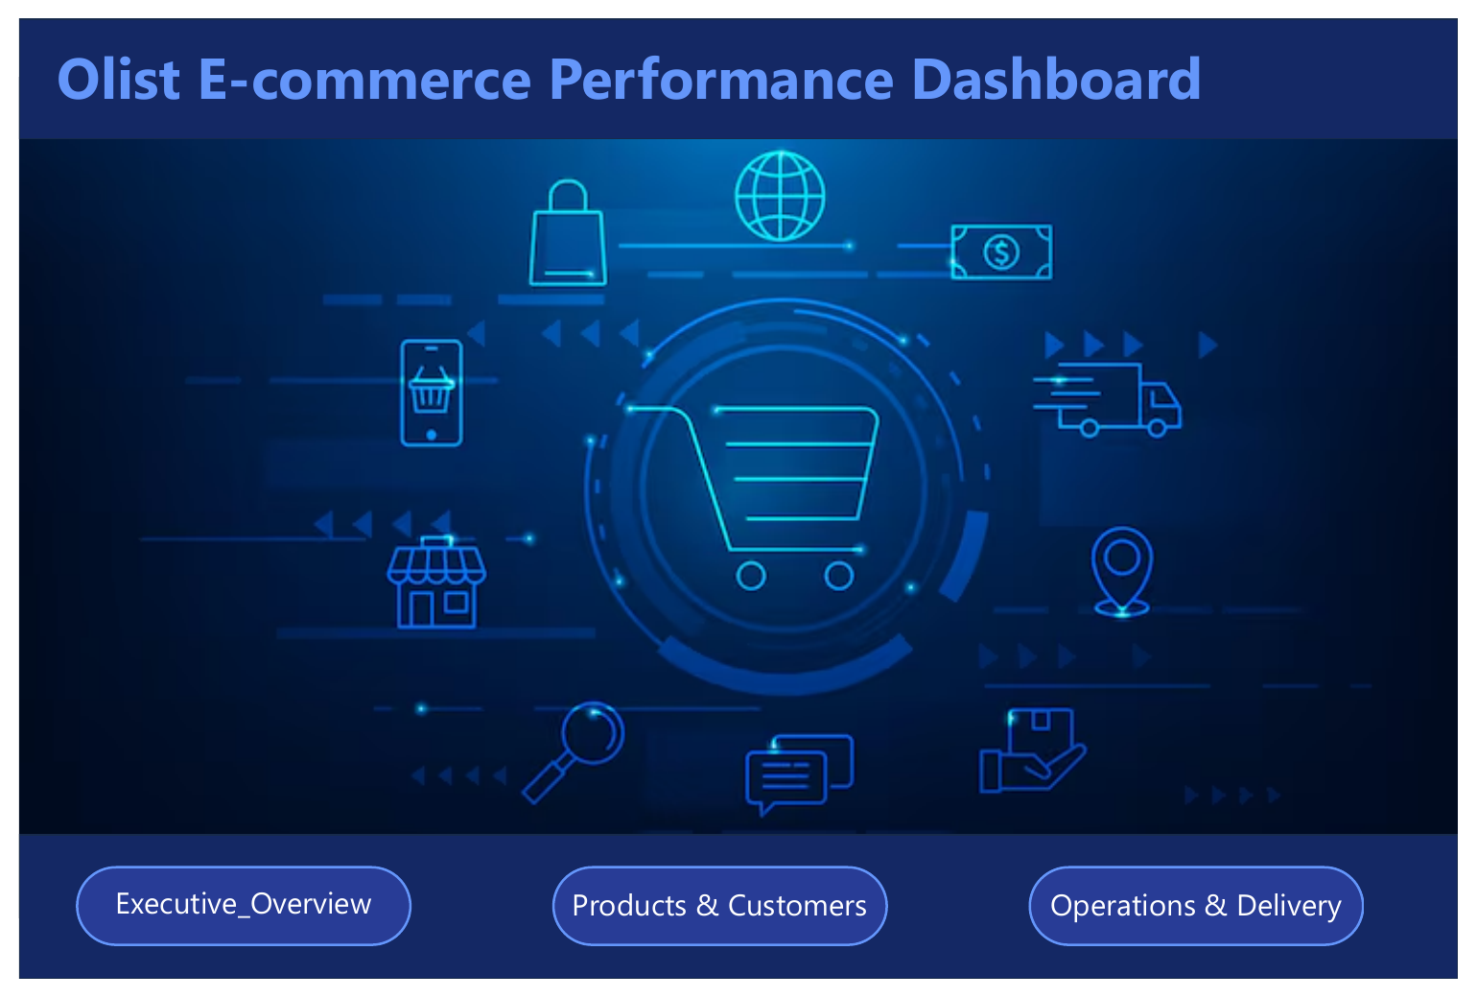
Dashboard: four pages, Jan 2017 to Aug 2018
Home
Navigation buttons to the three report pages.
Executive Overview
Revenue, sales, freight, orders, trend, geography, payments.
Products & Customers
Units, categories, repeat rate, monthly sales, YTD and MoM.
Operations & Delivery
Delivery days, late rate, location comparison, decomposition tree.
Olist E-Commerce Analysis · DEPI ITC Online Group 3, Team 3 · 8
Notes:
Mostafa Salem built the four-page report. Slicers for Year, Product Category and Customer State filter every page.

Slide 9
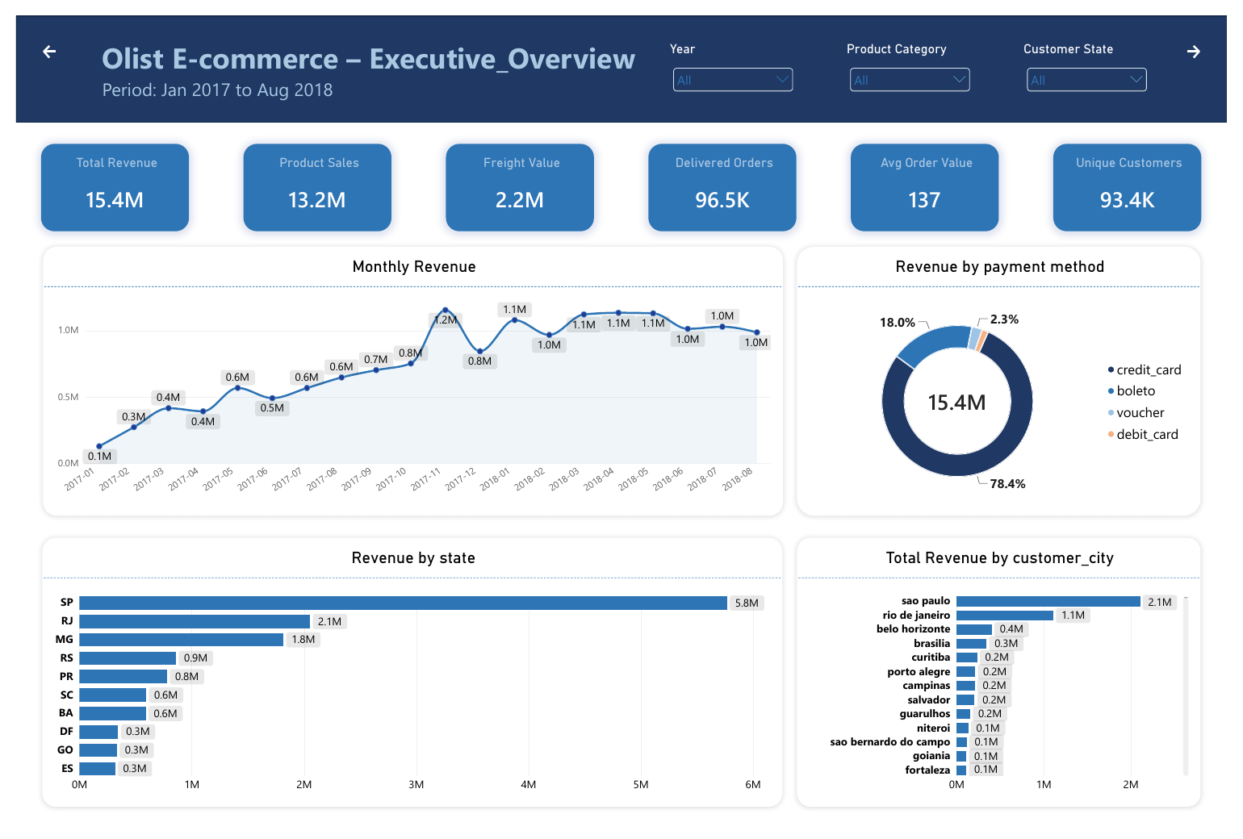
Executive Overview
15.4M
Total revenue (13.2M product sales + 2.2M freight)
96.5K
Delivered orders; 93.4K unique customers
137
Average order value; 78.4% of revenue by credit card
Olist E-Commerce Analysis · DEPI ITC Online Group 3, Team 3 · 9
Notes:
Headline view of the business. Currency is not stated on the dashboard, so we do not name one. São Paulo state leads with 5.8M in the state chart.

Slide 10
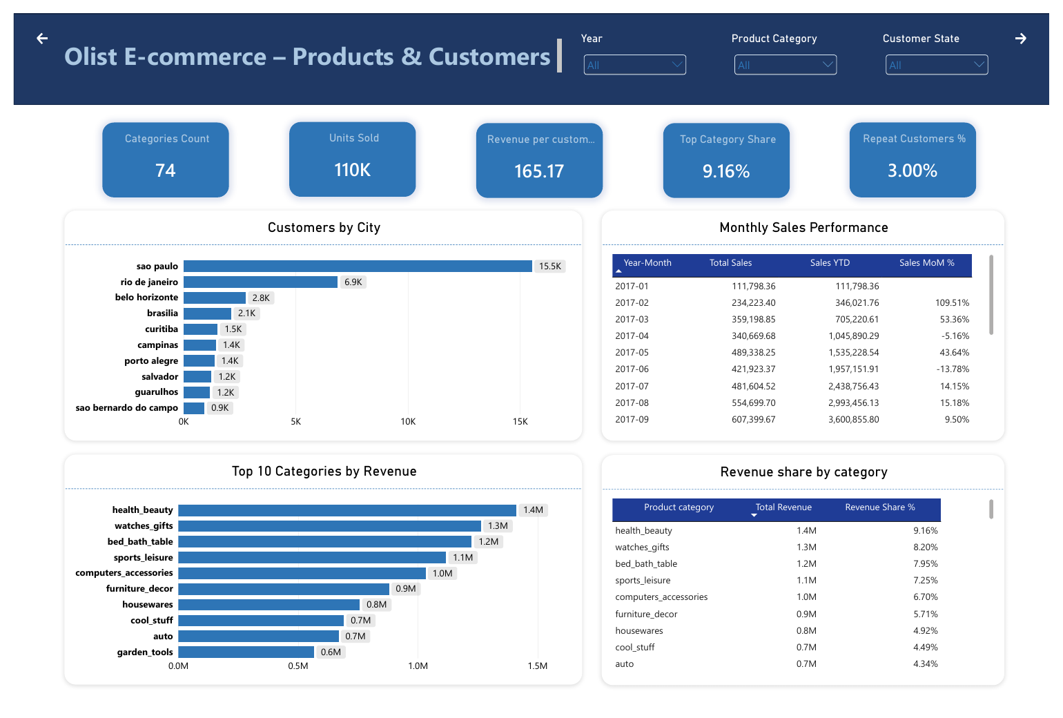
Products & Customers
110K
Units sold across 74 categories
9.16%
Top category share: health_beauty, then watches_gifts and bed_bath_table
3.00%
Repeat customers; revenue per customer 165.17
Olist E-Commerce Analysis · DEPI ITC Online Group 3, Team 3 · 10
Notes:
This page shows what sells and who buys. Repeat customers are only 3 percent, which is the most striking number here.

Slide 11
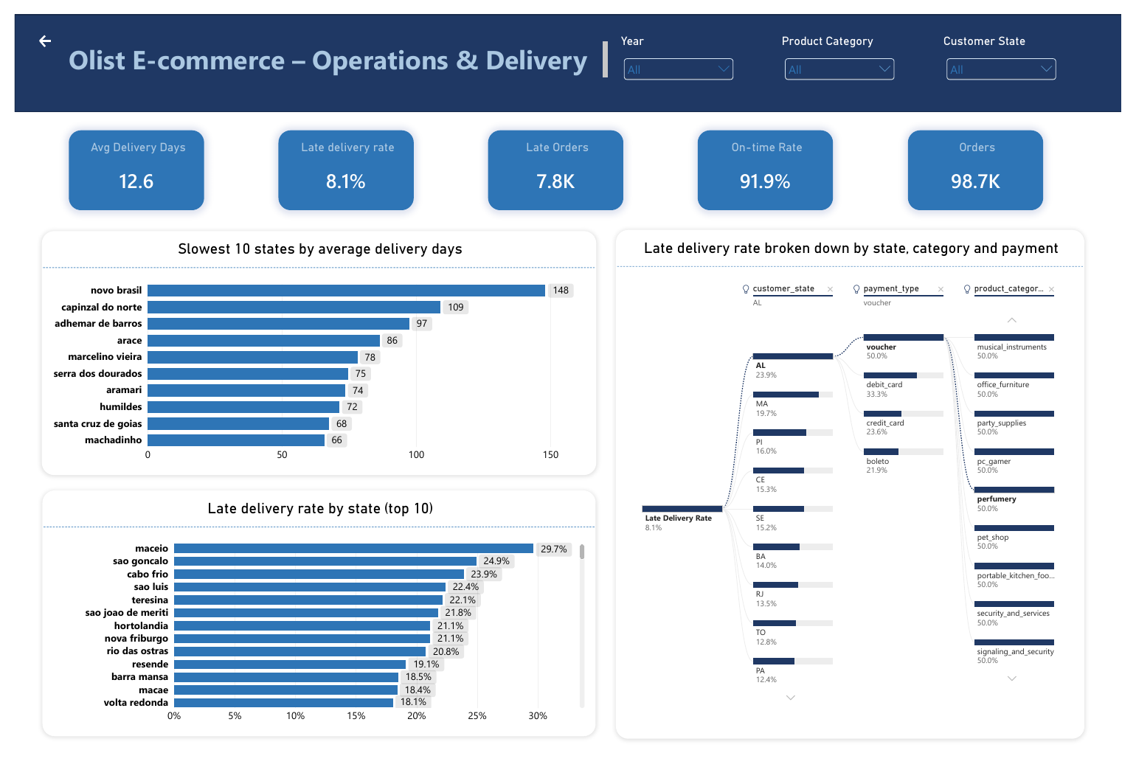
Operations & Delivery
12.6
Average delivery days
8.1%
Late-delivery rate (7.8K late orders); on-time rate 91.9%
Caution: small samples (e.g. categories at 50% late) can mislead.
Olist E-Commerce Analysis · DEPI ITC Online Group 3, Team 3 · 11
Notes:
Operations view. Note the page's Orders count (98.7K) differs from Delivered Orders (96.5K) on the first page, so the bases are different.

Slide 12
Main findings and possible implications
15.4M
38%
39%
3%
Total revenue
of revenue from São Paulo state (5.8M)
of revenue from the top five categories
repeat customers
Delivery: 12.6 days on average, 8.1% late. Late rates are higher in some northeastern states.
Hypotheses to investigate, not proven causes: low repeat purchase suggests a retention opportunity; regional late rates suggest reviewing delivery estimates and carriers.
Olist E-Commerce Analysis · DEPI ITC Online Group 3, Team 3 · 12
Notes:
Figures were checked against the dashboard screenshots: 5.8M of 15.4M is about 38 percent, and the top five category shares add to about 39 percent. These are descriptive findings; the recommendations are hypotheses.

Slide 13
Limitations, trade-offs and lessons
Accuracy vs Redundancy
Late is not caused
We had to Lose some accuracy over preventing redundancy, which showed up in the payment installment column
Delivery after the estimate does not show whether carriers or estimates are at fault.
Small samples mislead
Labels and data gaps
Tiny cities or categories skew averages and late rates; use a minimum sample threshold.
Some location charts label cities as states; identifiers are used instead of names; currency is not stated.
Olist E-Commerce Analysis · DEPI ITC Online Group 3, Team 3 · 13
Notes:
Be candid here. These limits shape how the dashboard should be read. Lesson learned: validate relationships and sample sizes before drawing conclusions.

Slide 14





Credits: project contributors
Mohamed Sokarno
Mahmoud Al-Nabawi
Mohamed El-Gml
Dataset discovery, database creation, SQL schema and loading, UTF-8 fix, project review, repository organisation, coordination.
Source-dataset ERD and contribution to the data dictionary.
Python data cleaning, preparation and notebook.
Mahmoud Saqr
Mostafa Salem
Power BI measures and Calendar table.
Four-page Power BI dashboard.
Olist E-Commerce Analysis · DEPI ITC Online Group 3, Team 3 · 14
Notes:
Thank each contributor for their actual role.

Slide 15
Leadership and program acknowledgements
Mohamed Sokarno
Eman Ghanem
Team Leader.
ITC mentor and lecturer.
Esraa Yahia
Mahmoud Raslan
ITC_ONL5_Dat3_G3 operator.
ITC CEO.
Program acknowledgements recognise support and guidance; project components were implemented by the contributors listed on the previous slide.
Olist E-Commerce Analysis · DEPI ITC Online Group 3, Team 3 · 15
Notes:
Close by thanking the program team. Thank you.

